Slide 1
Secure Data Hiding in Images Using Steganography
CAPSTONE PROJECT
Presented By: BALAJI B
Student Name : BALAJI B
College Name & Department : SRM-IST & CS

Slide 2
OUTLINE
Problem Statement
Technology used
Wow factor
End users
Result
Conclusion
Git-hub Link
Future scope

Slide 3
Problem Statement
To enable secure and covert communication by embedding encrypted messages into images, ensuring data confidentiality and integrity. This project addresses the need for a reliable method to hide sensitive information within digital images without noticeable quality loss.

Slide 4
Technology used
Programming Language: Python 3.8+ 🐍
Libraries:
OpenCV📦 (Image processing)
Hashlib🔐 (SHA-256 hashing for password protection)
Random🎲 (Random pixel selection)
Encryption: Caesar Cipher 🔒
Platforms: Windows, MacOS, Linux

Slide 5
Wow factors
Double-Layer Security: Combines Caesar Cipher encryption and SHA-256 hashing for robust data protection.
Randomized Pixel Embedding: Messages are hidden in randomly selected pixels, making detection nearly impossible.
Minimal Image Quality Loss: Encrypted images retain high visual quality.
Cross-Platform Compatibility: Works seamlessly on Windows, MacOS, and Linux.
Ease of Use: Simple command-line interface for encrypting and decrypting messages.

Slide 6
End users
Individuals: For personal privacy and secure communication.
Businesses: To protect sensitive information during digital transactions.
Government Agencies: For covert communication and data security.
Cybersecurity Professionals: As a tool for research and training.
Students and Educators: For learning and teaching data security concepts.

Slide 7
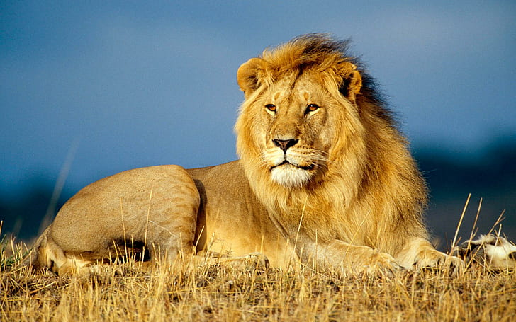

Results
Before Encryption (my-pic.jpg)
After Encryption (encrypted-Img.jpg)

Slide 8
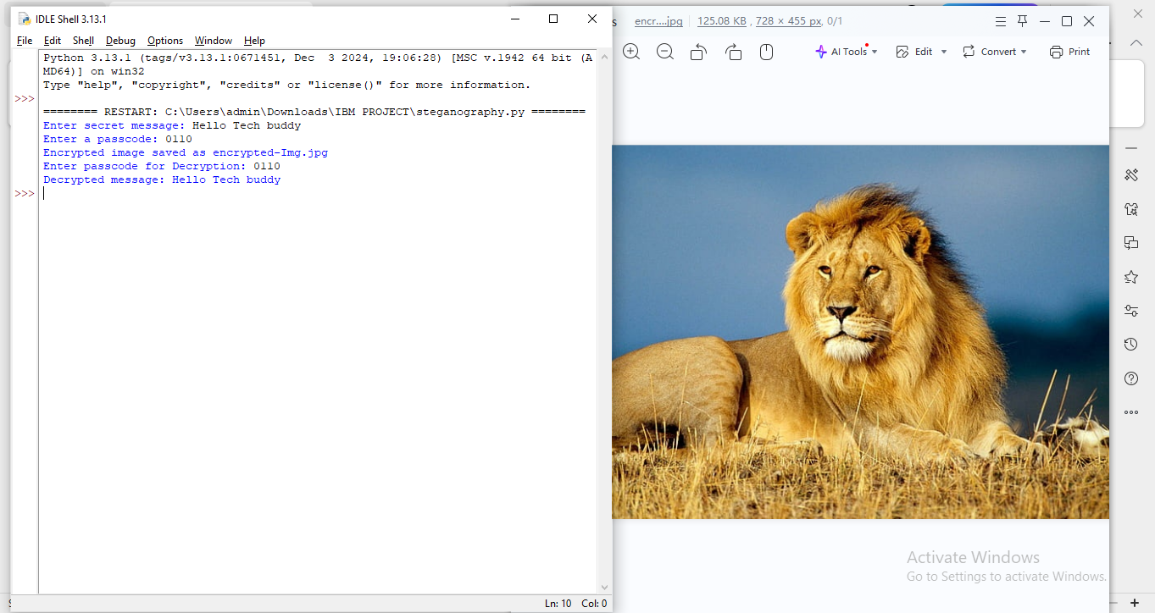
RESULTS

Slide 9
Conclusion
This project demonstrates a highly secure and efficient method for data hiding using steganography. By combining encryption, hashing, and randomized pixel selection, it ensures maximum security and minimal image quality loss. It is a versatile solution for individuals, organizations, and cybersecurity professionals seeking to protect sensitive information. Future enhancements, such as advanced encryption algorithms and a user-friendly GUI, will further elevate its capabilities.

Slide 10
GitHub Link
https://github.com/balaji-0111/Secure-Data-Hiding-In-Images-Using-Steganography-.git

Slide 11
Future scope(optional)
Implement advanced encryption algorithms (e.g., AES).
Develop a user-friendly GUI for ease of use.
Extend to video and audio steganography.
Enhance resistance to steganalysis techniques.
Add support for multiple image formats.

Slide 12
THANK YOU

